Slide 1
Warm Up
What does patriotism mean to you? Do you think it’s important for people to be patriotic? Why or why not?
Is it patriotic or anti-American to criticize the US government? Explain.

Slide 2
Show Video!
https://www.youtube.com/watch?v=uwwmPcpoWPQ&t=176s

Slide 3
Sedition in World War I:
Were critics of the First World War anti-American?

Slide 4
For Discussion:
What did President Wilson do to promote patriotism and restrict dissent during World War I?

Slide 5
For Discussion:
Do you think these were necessary decisions?

Slide 6
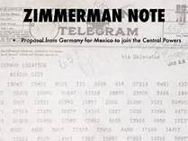
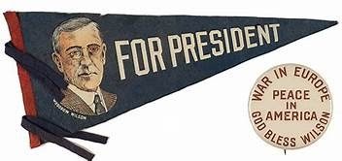
Public opinion on WWI was divided in the U.S. Some Americans, notably socialists, Christian pacifists, anarchists, women’s groups, unionists, and intellectuals, opposed the war. Some of these pacifists believed war was immoral, while “radicals” believed the government was entering war not to “make the world safe for democracy,” as Wilson claimed, but rather to serve the interest of capitalists. Other Americans strongly supported U.S. entry into the war in light of the Zimmerman telegram and the sinking of the Lusitania.

Slide 7
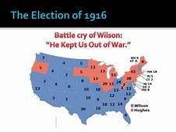
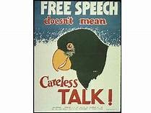
In 1916 President Wilson won re-election running on the slogan “He Kept Us Out of War.” After the revelation of the Zimmerman telegram and Germany beginning a program of unrestricted submarine warfare that threatened U.S. commercial shipping, Congress declared war in April 1917. That same month Wilson established the Committee on Public Information, a propaganda agency that galvanized public support for U.S. war aims. The president pushed through Congress the Espionage Act of 1917 and the Sedition Act of 1918, which suppressed anti-British, pro-German, and anti-war opinions. Over 1,500 people were prosecuted and over 1,000 convicted under these laws, many for small acts of dissent. His administration saw the arrest and deportation of many foreign-born, antiwar radicals and drew closer to pro-war unions.

Slide 8
Now…
Answer # 1 - 3 on the graphic organizer on page 3
Then…read Document A & B
Make sure to annotate each document as you’re reading!
After reading each document, write down the two most important things you read in each document

Slide 9
Now…
Fill out Graphic Organizer
Can work with partner…if you’d like
Homework if you don’t finish?

Slide 10
Warm Up
Do you think Debs and Schenk were anti-American? Why or why not?

Slide 11
To counter opposition to the war, the US government passed the Espionage and Sedition Acts, which limited the rights of Americans.
Now, read Document C & answer guiding questions.
The purpose for your reading is to consider whether or not Debs and Schenk were guilty of breaking the law

Slide 12
Debrief:
Both Debs and Schenck were arrested for breaking the law, found guilty, and sentenced to jail
Debs served 32 months in prison until President Harding released him in 1921; Schenck spent 6 months in prison

Slide 13
Read Document D
What does the ruling say?
Do you agree with the ruling?
Consider this ruling within its historical context when answering the question

Slide 14
Paragraph:
Were critics of WW1 anti-American? Include evidence drawn from at least three of these documents
Remember:
Cite documents
QUOTE INTEGRATION!!
Don’t say “I”
State as fact!
PROOFREAD!!

