Slide 1
Warm Up—11/6/23
What do you remember about Woodrow Wilson?
Write down everything you know about World War I

Slide 2
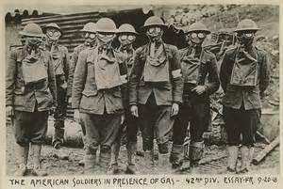
US Entry into World War I

Slide 3
Causes of World War I:
Militarism—build up of military
Imperialism—when a stronger country takes over a weaker one that can’t defend itself
Nationalism—extreme pride in one’s country
Alliance system—when country’s are ‘friends’ with other country’s…they’ll have each other’s back

Slide 4
The Alliances:
Allies (Triple Entente):
France
Russia
Great Britain
Italy
United States
Central Powers:
Germany
Austria-Hungary
Ottoman Empire

Slide 5
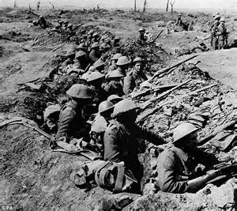
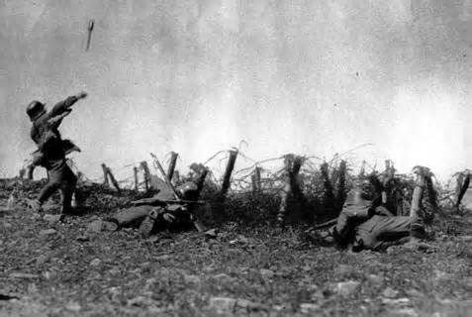
The War
There was mass death and destruction
Trench Warfare, ‘No Man’s Land’
The United States sympathized with Britain but didn’t get involved until April 6, 1917
So why did the US enter WW1 after it had decided to stay neutral?

Slide 6
President Woodrow Wilson
Elected president in 1912
He won with less than 50% of the popular vote because the Republican Party split into the Progressive Party (Roosevelt) and the Republican Party (Taft)
Democrat from New Jersey, but he won the support of many progressives because he opposed political machines

Slide 7
Wilson’s Accomplishments:
Signed the Keating-Owen Child Labor Act
Clayton Anti-trust Act
Created the Federal Trade Commission

Slide 8
Controversy during his administration:
Views on Race:
Supported segregation
Had a screening of “Birth of a Nation” at the White House
This movie celebrated the KKK

Slide 9
Now…
Read & annotate Documents A & B
Answer the guiding questions on the following page (4)

