Slide 1
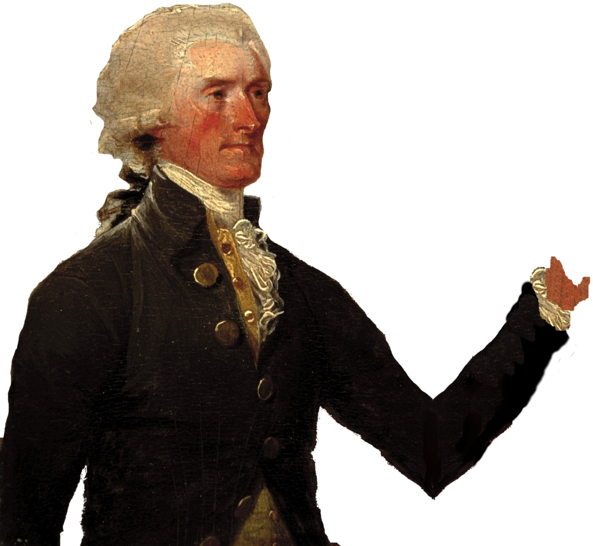
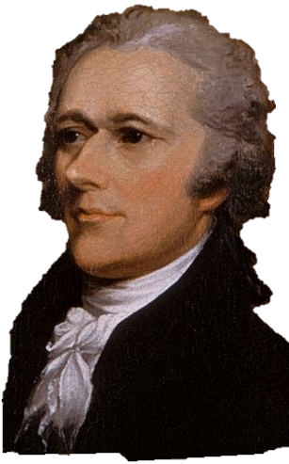
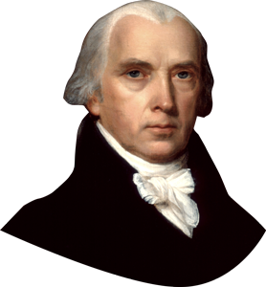
Notes:
Disc 2, Track 5 – “The Room Where It Happens” – where they strike the deal that created the Compromise of 1790.

Slide 2
Jefferson arranges a meeting with Congressman James Madison
The debt plan was approved
Moved the national capital to Washington DC (pleasing Southerners)

Slide 3
Factions develop from the cabinet
Hamilton & his allies are Federalists
Jefferson, Madison, & the opposition become the Democratic-Republican Party
Notes:
After this slide play Disc 2, Track #7 “Cabinet Battle #2”. covers the debate over neutrality in the war between France & England

Slide 4
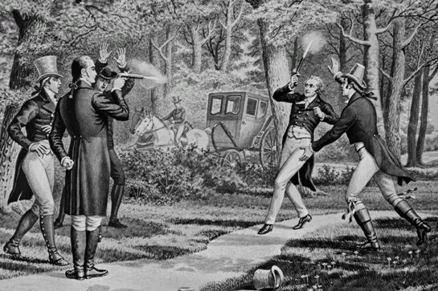
Notes:
Track 20 – “Your Obedient Servant” highlights some of their disagreements prior to the duel. The track 22 “The World Was Wide Enough” covers the duel itself.

Slide 5
Aaron Burr – the Vice President & longtime rival challenges him
Hamilton campaigned against him & insulted his character
Hamilton throws his shot, but Burr hits Hamilton & he dies the next day
Notes:
Of significance is that Hamilton’s son Philip died in a duel (to defend his father’s honor) before this.

Slide 6
What do you feel is Alexander Hamilton’s greatest legacy to America? Look back through the notes you took then explain briefly.
Notes:
His wife Eliza lived another 50 years and established the first orphanage in New York City to help children like Hamilton gain a better life. His financial system endured and proved to help create the greatest economy in the world and promote trade and a stable financial system. Burr became a villain. He was tried in New Jersey and New York for murder but acquitted.

