Slide 1
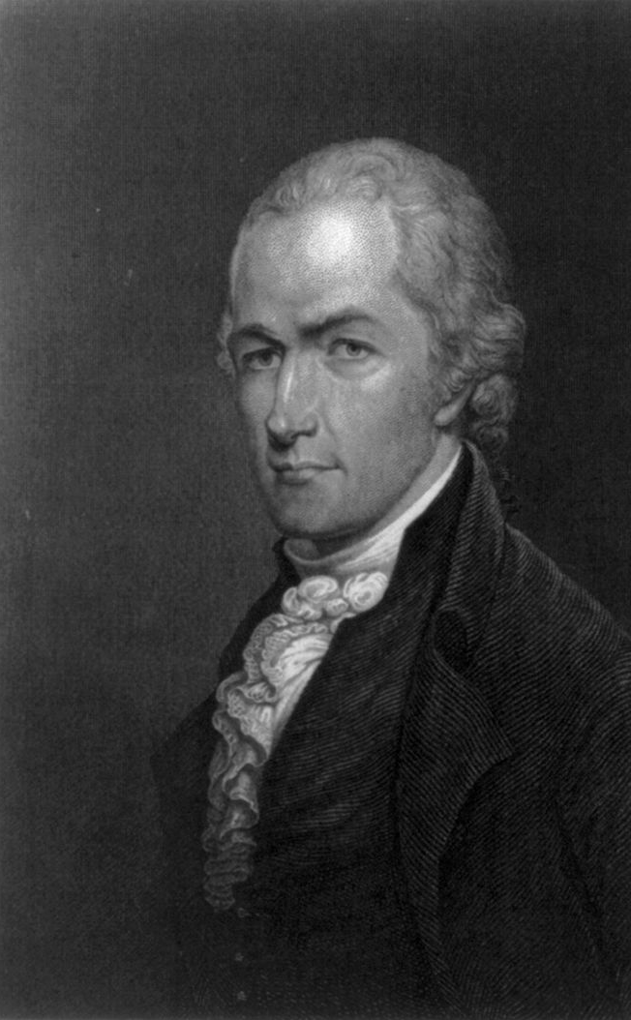
Supported a strong central government
Presented a plan deemed too similar to England’s
President for life
But could impeach for corruption and abuse
2 house legislature and Supreme Court
Notes:
Hamilton’s plan featured a president-for-life with the ability to impeach him for corruption or abuse but also a 2 house legislature and Supreme Court.

Slide 2
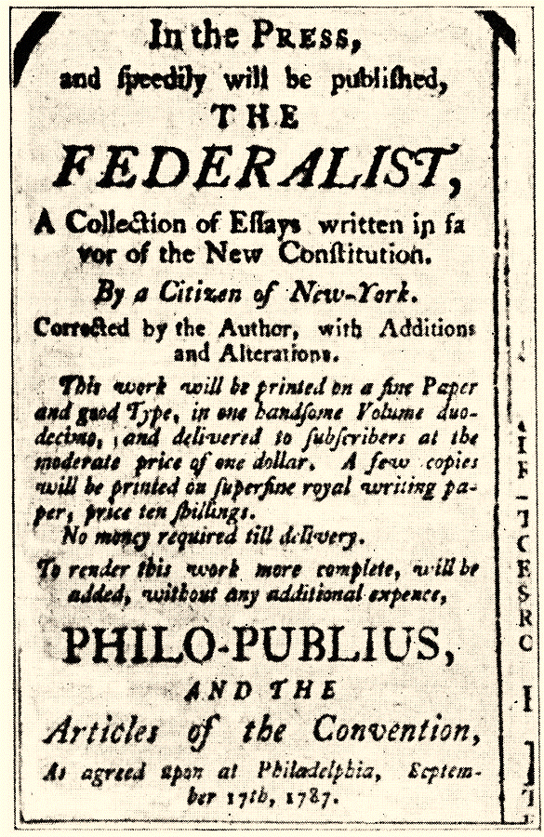
Recruits John Jay and James Madison to join him in writing essays defending the Constitution
Hamilton wrote 51 of the 85 essays anonymously
Notes:
The Federalist Papers were all written anonymously under the pseudonym Publis. Hamilton took the lead and the papers are credited with rallying support in the states to ratify the Constitution.

Slide 3
What are some of Hamilton’s personal characteristics? How do these both help and hurt him?
Notes:
Disc 1, Track 23 – “Non-Stop”

Slide 4
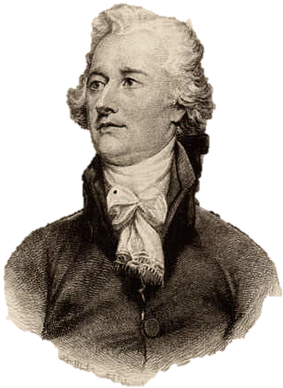
Appointed by George Washington in 1789
Argued that the Constitution’s implied powers provide authority to fund national debt, assume state debts & create the Bank of the US
Notes:
Hamilton was one of Washington’s closest advisors and one of his most powerful cabinet members. He actually saw his position to be similar to a prime minister.

Slide 5
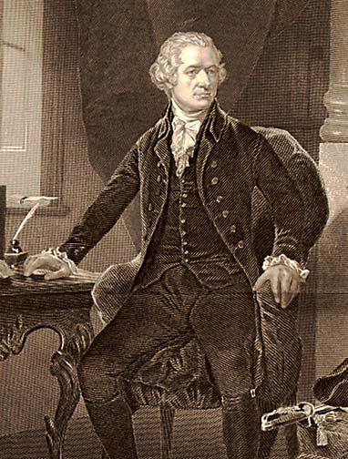
Hamilton argued we all fought for freedom so the US should assume all state debt
However some states owed much more than others
Notes:
This will be highlighted in Jefferson’s part of the cabinet battle song.

Slide 6
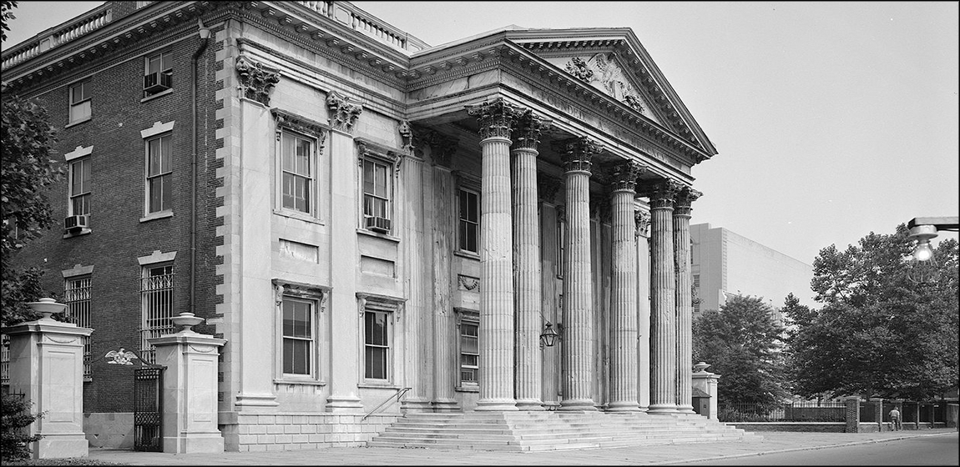
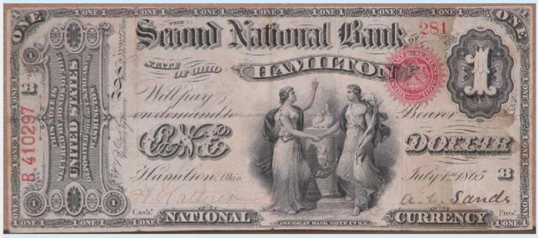
US had debts from the war but each state had different currency
Provides financial stability and a respected currency for economy
Notes:
The National Bank would be successful but a continued hot topic and later vetoed by President Andrew Jackson.

Slide 7
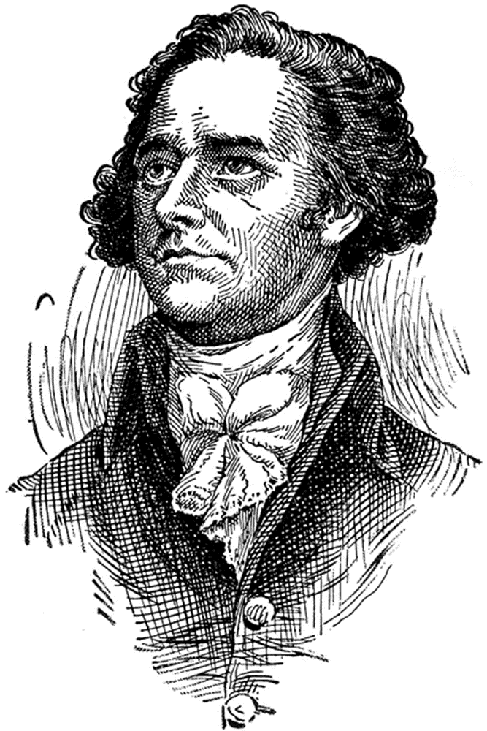
“A national debt, if it is not excessive, will be to us a national blessing.”
Paying it off would raise America’s standing and justify taxation
Notes:
The debt would be a blessing because it would give wealthy creditors a financial interest in America’s success. If America pays its debts then people are making money and would not want to see the country fail.

Slide 8
Summarize Jefferson’s argument & Hamilton’s response.
Whose argument do you support & why?
Notes:
Disc 2, Track 2 – “Cabinet Battle #1” (1 very minor explicit lyric) Another resource is a video clip from HBO’s “John Adams” available on Youtube . The links constantly change as videos are taken down, but search the clip of for Alexander Hamilton and Thomas Jefferson speaking about the bank--it provides a quick (about 3 minutes) overview of their positions.

Slide 9
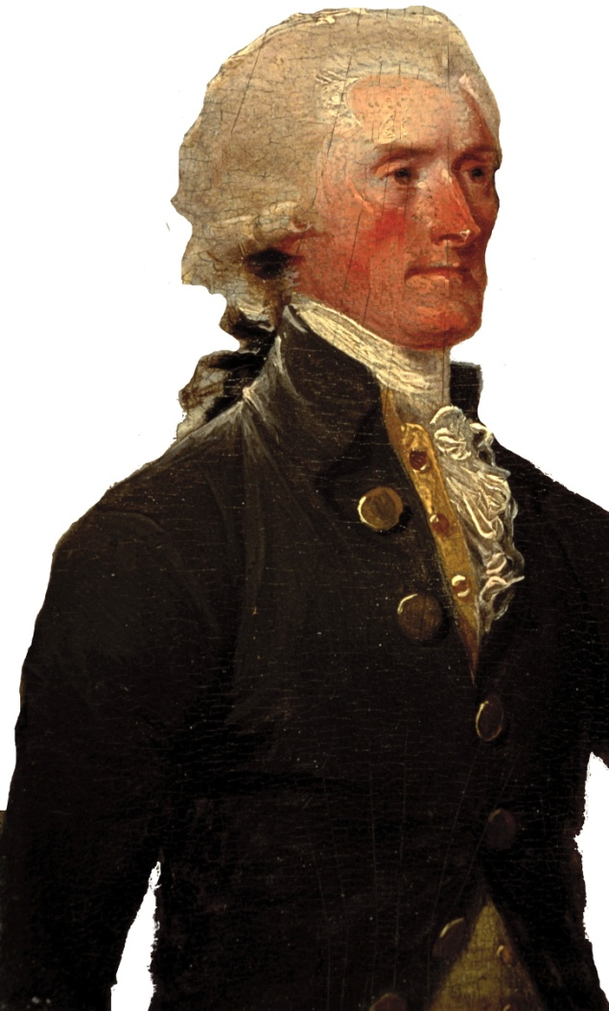
Secretary of State in Washington’s Cabinet
Argued the plan favored wealthy Northern creditors
Virginia (his state) had little debt
Notes:
Note that Jefferson would later resign his position as Secretary of State in 1793 due to his conflicts with Hamilton and the president and a desire to return to a private life.

