Slide 1
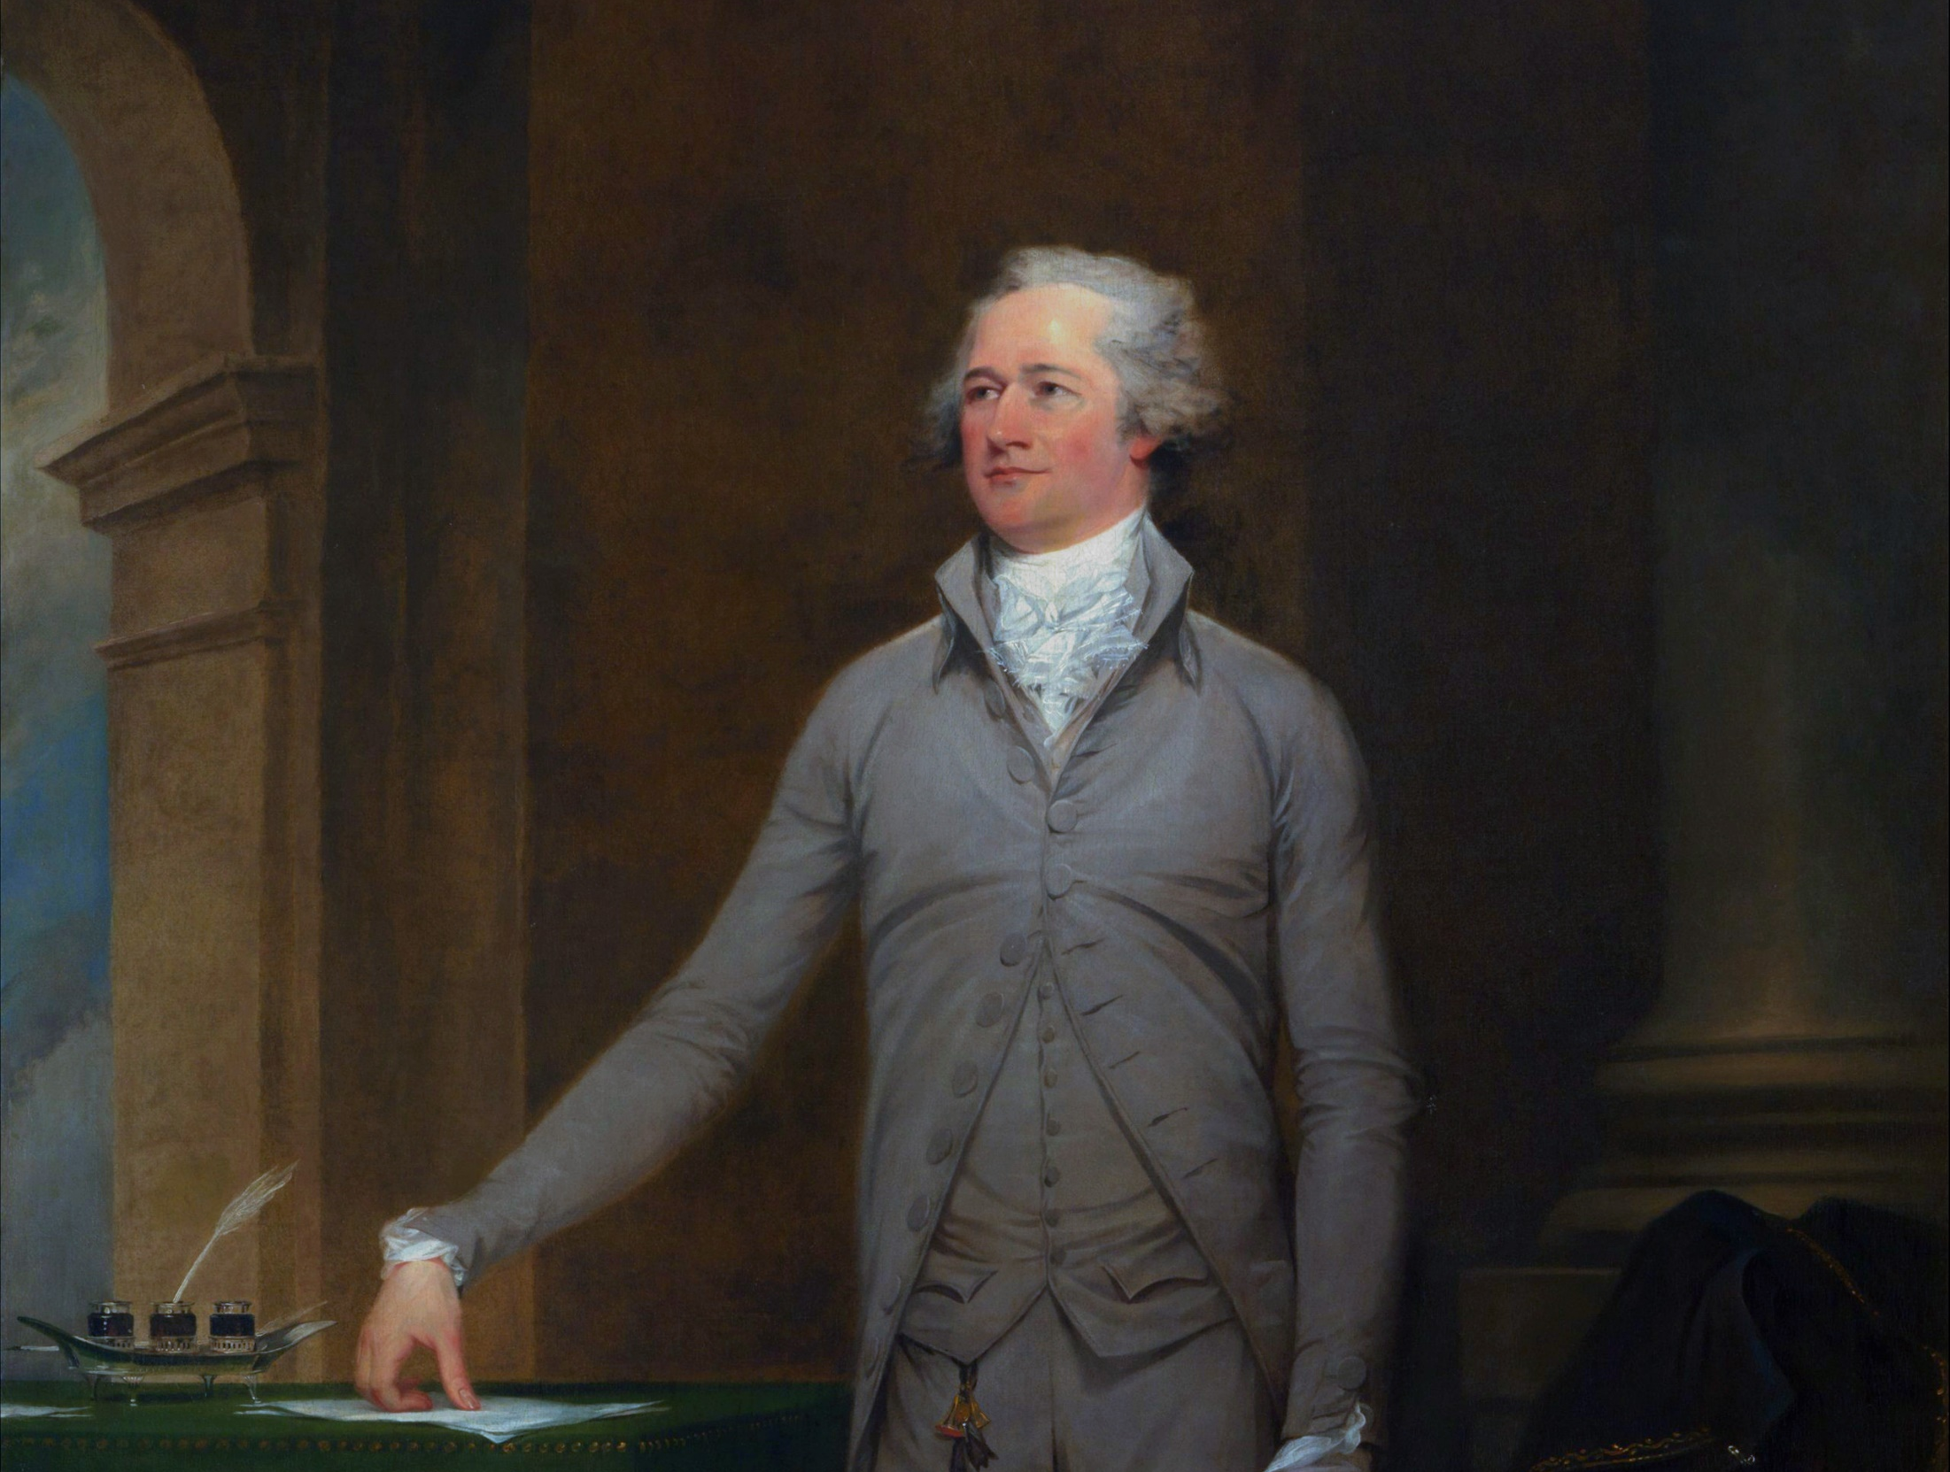
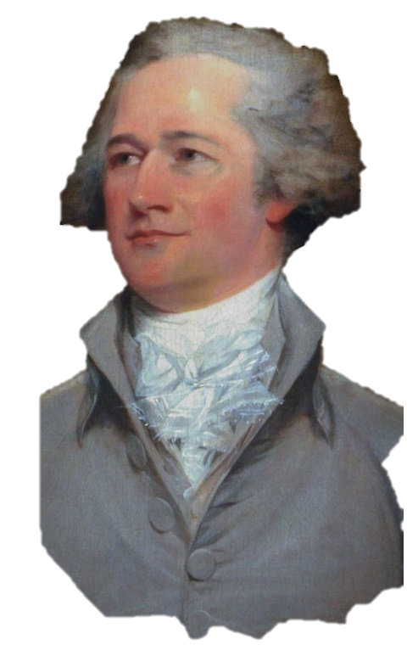
Notes:
warm up: a KWL chart on Hamilton

Slide 2
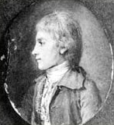
Born on the Caribbean island of Nevis ~1755, later moved to St. Croix
Orphaned in 1768 after his father abandoned the family & his mother died
An essay he wrote impressed community leaders who collected a fund to send him to school in the American colonies
Notes:
Background image shows the island of Nevis. After he was orphaned: Hamilton was known to be a very bright boy and he was taken in as a clerk for a trading company which taught him much about commerce and trade. He spoke both French and English and distinguished himself with his hard work and attention to details. The slave trade’s prominent role in Caribbean society and the horrors he likely witnessed growing up influenced his later abolitionism. The essay he wrote was about a hurricane that devastated the island and was published in the local newspaper.

Slide 3
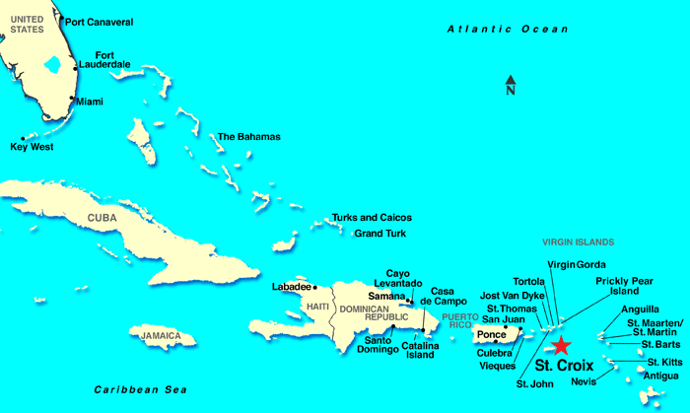
Notes:
Play Track 1 – “Alexander Hamilton” and have students listen while they label and color the maps on their graphic organizer pages. Brief discussion about some of the struggles he faced as a child and how that compares to what teens today face.

Slide 4
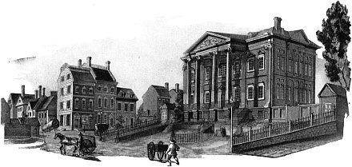
Attends King’s College in NY
Quickly joins the Patriot cause & writes essays against Loyalist supporters
Notes:
At 17-years-old, Hamilton first studied in NJ and completed 3 years worth of studies in just a year. He wished to go to Princeton but they rejected his requests for similarly accelerated studies. Kings College is known today as Columbia University and he enrolled in 1773,

Slide 5
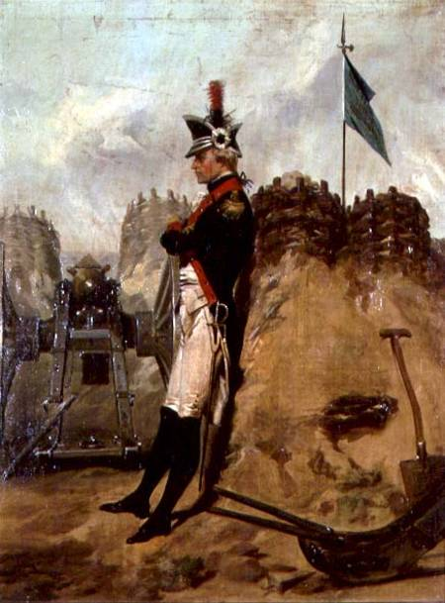
Joins a volunteer militia: The Hearts of Oak
Later elected captain of an artillery
Invited by George Washington to be his chief aide de camp
Commanded a battalion that helped secure victory at Yorktown
Notes:
In 1775, Hamilton helped lead a daring raid on British cannons in Ney York City in which he and his men captured 21 of the battery’s 24 guns. One of Image shows “Alexander Hamilton in the Uniform of the New York Artillery” by Alonzo Chappel

Slide 6
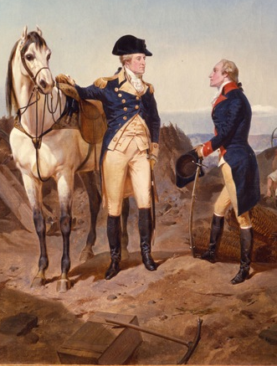
What are some of the struggles and problems Washington describes?
What are some of Hamilton’s ideas for victory?
Notes:
For this slide, play Track 8 – “Right Hand Man” (Note - minor explicit lyric). Listen to the whole song before writing their answers-- Hamilton’s ideas are not until close to the end and Washington’s reasons are spread throughout. Painting shows “Hamilton's First Meeting with George Washington” by Alonzo Chappel

Slide 7
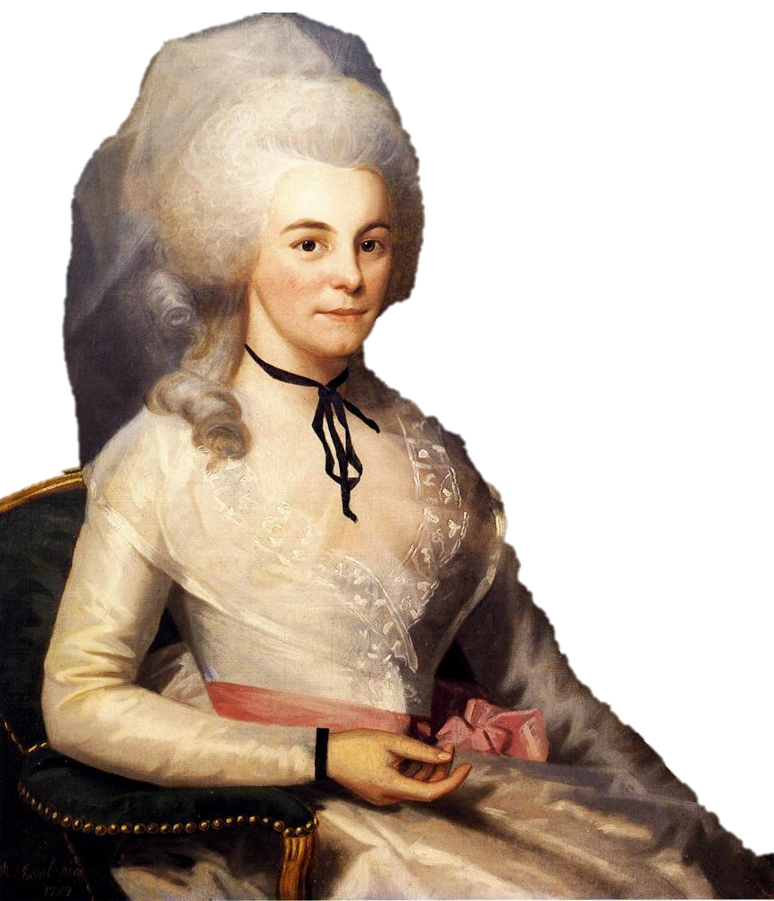
Meets the wealthy & connected Eliza Schuyler
They marry at her family’s mansion in 1780
Notes:
Track 5 – “The Schuyler Sisters” to know more about his wife and her family.

Slide 8
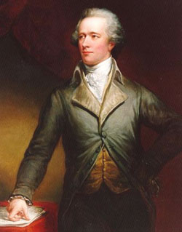
NY’s representative to the Articles of the Confederation
Resigns, frustrated with its weakness
Returns to NY & practices law
Notes:
Articles of Confederation--go over the weaknesses of it here (no common currency, no executive, no power to tax, etc).
An excellent track to play right before this slide is Disc 1, Track 18 “Guns and Ships” –It covers how victory came about at Yorktown through Lafayette and Hamilton.

Slide 9
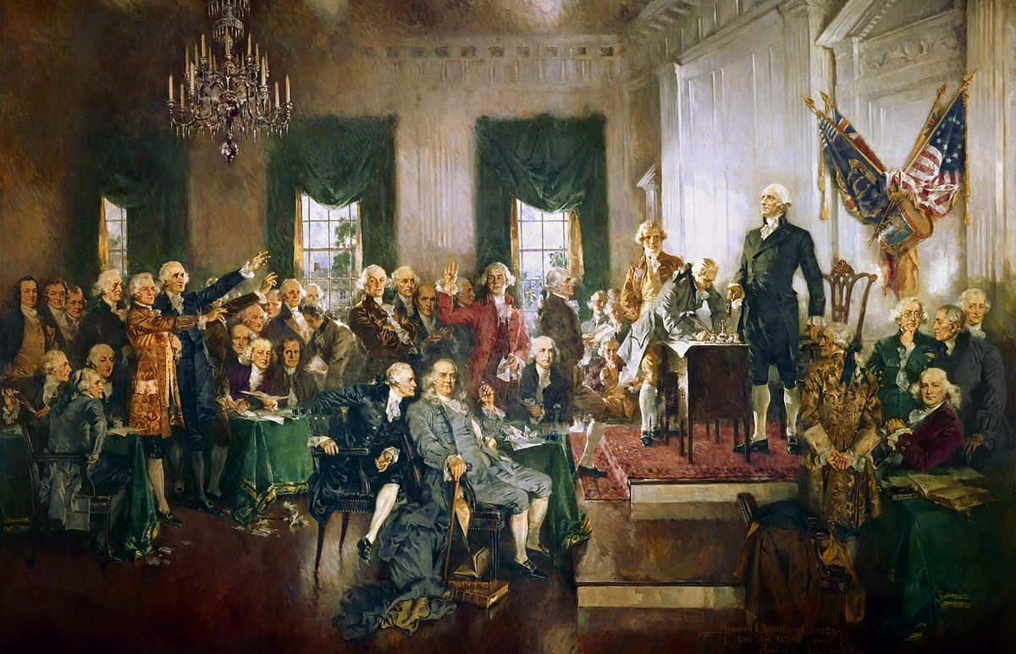
Notes:
In the painting, Hamilton is in the front-center, speaking into Ben Franklin’s ear.

