Slide 1
The Declaration of Independence:
An Explanation

Slide 2
The Document with the signatures

Slide 3
Signed, July 4, 1776
The Continental Congress appointed a five-person committee to write a document where the colonists declared themselves independent from Britain, however it was written primarily by Thomas Jefferson
This document:
Defined colonists’ rights
Their complaints towards Britain
Declared their independence
Jefferson was influenced by philosopher, John Locke

Slide 4
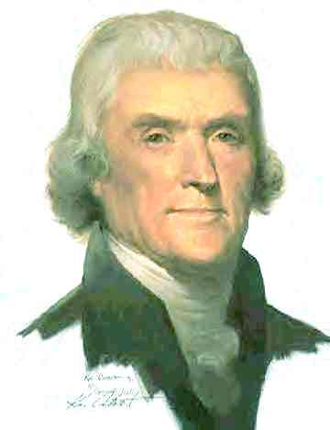
Locke vs. jefferson
Natural rights according to Locke: Life, Liberty, and Property
Natural rights according to Jefferson: Life, Liberty, and the Pursuit of Happiness

Slide 5
Working on the declaration:
Frnaklin, Addams, and Jefferson editing the document

Slide 6
Document’s purpose (Preamble)
Text:
Our “English”
“When in the course of human events, it becomes necessary for one people to dissolve the political bands which have connected them with another, and to assume among the powers o the Earth, the separate and equal station to which the Laws of Nature and of Nature’s God entitle them, a decent respect to the opinions of mankind requires that they should declare the causes which impel them to the separation”
Whenever a group of people needs to split from their government…and assert their God given independence and equality…It’s always important to spell out the reasons why.

Slide 7
What the colonists felt their “natural rights” were:
Text:
Our “English”
“We hold these truths to be self-evident, that all men are created equal, that they are endowed by their Creator with certain unalienable Rights, that among these are Life, Liberty, and the pursuit of Happiness. That to secure these rights, Governments are instituted among Men, deriving their just powers from the consent of the governed.”
We think it’s pretty obvious... that God created every person equal, and he gave each person specific rights upon their birth which should never be trampled upon…these include the right of the people to live life in freedom (without undue harm), and pursue their dreams and goals. The very reason we have man-made governments is to protect these rights, not to interfere with them. Furthermore, whatever power and authority governments have are given by the people’s permission and limited to their protection.

Slide 8
Justification for separating from britain:
Text
Our “English”
That whenever any Form of Government becomes destruction of these ends it is the right of the people to alter or to abolish it, and to institute new government, laying its foundation on such principles and organizing its power in such form as to them shall seem most likely to effect their safety and happiness.”
When any government starts to undermine the very purpose of protecting the life, freedoms, and happiness of the people, then they have the right change the government or, yes, even to pull the plug on the government if things get too bad. he people have the right to set up a newer, better government based and organized on tried and true rules that protect, rather than threaten, their safety and happiness.

Slide 9
This is an important cause they are fighting for:
Text
Our “English”
“Prudence, indeed, will dictate that Governments long established should not be changed for light and transient causes; and accordingly all experience hath shown that mankind are more disposed to suffer, while evils are sufferable, than to right themselves by abolishing the forms to which they are accustomed.”
Now, it’s not wise to change a long standing government for some trivial or fleeting reason or for the latest political fad; And, in fact, history shows that people are more likely to put up with unbearable evil (They even get used to it!), than they are to correct the problem. You know the saying: Put a frog in hot water and he’ll jump out. But put him in cool water and gradually turn up the heat, and he’ll fry to death.

Slide 10
How these people and this government are different:
Text:
Our “English”
“But when a long train of abuses and usurpations, pursuing invariable the same Object evinces a design to reduce them under absolute Despotism, it is their right, it is their duty, to throw off such Government, and to provide new Guards for their future security.”
But when a government becomes tyrannical and abusive with consistent, repeated violations of the people’s rights, with the intent to make them slaves of the state, then the people have the right–in fact, the duty to revolt against the government, and put new rules in place to protect their future rights.

Slide 11
“the declaration of independence” by john trumbull
Today located in the Rotunda of the Capitol
Shows the five person committee presenting the document
Also on the $2 bill
Completed 1819

